Slide 1


Python & Deep Learning
Keras for Deep Learning Research

Slide 2
Feedback is greatly appreciated!

Slide 3

Overview
Difference between FNN and RNN
Significance of context
Recurrent Neural Networks
RNN
LSTM
Use case: Twitter Sentiment Analysis

Slide 4
Motivation
“Humans don’t start their thinking from scratch every second , rather their thoughts have persistence”
Example: When you read an essay, you understand each word based on your understanding of previous words

Slide 5
Significance of context
Recall the 5th digit of your phone number
Sing your favorite song beginning at third sentence
Recall 10th character of the alphabet
Probably you will start from the beginning of the stream in each case…
because in sequences, order matters!
Idea: Retain the information preserving the importance of order

Slide 6
Why Recurrent Neural Networks
Imagine you want to classify what kind of event is happening at every point in a movie
Traditional neural networks can’t do this and it is a major shortcoming
Because, It’s unclear how a traditional neural network could use its reasoning about previous events in the film to inform later ones

Slide 7
Answer is Recurrent Neural Network
Recurrent neural networks address this issue :
They are neural networks with loops in them, allowing information to persist

Slide 8
Recurrent Neural Network (RNN)

Slide 9
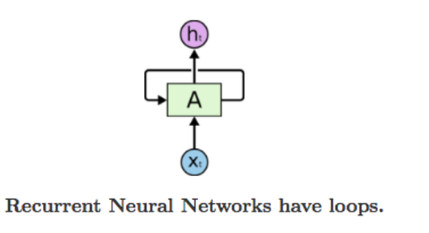
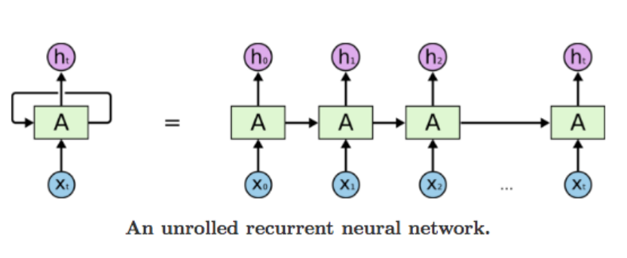
Recurrent Neural Network
A recurrent neural network can be thought of as multiple copies of the same network, each passing a message to a successor

Slide 10
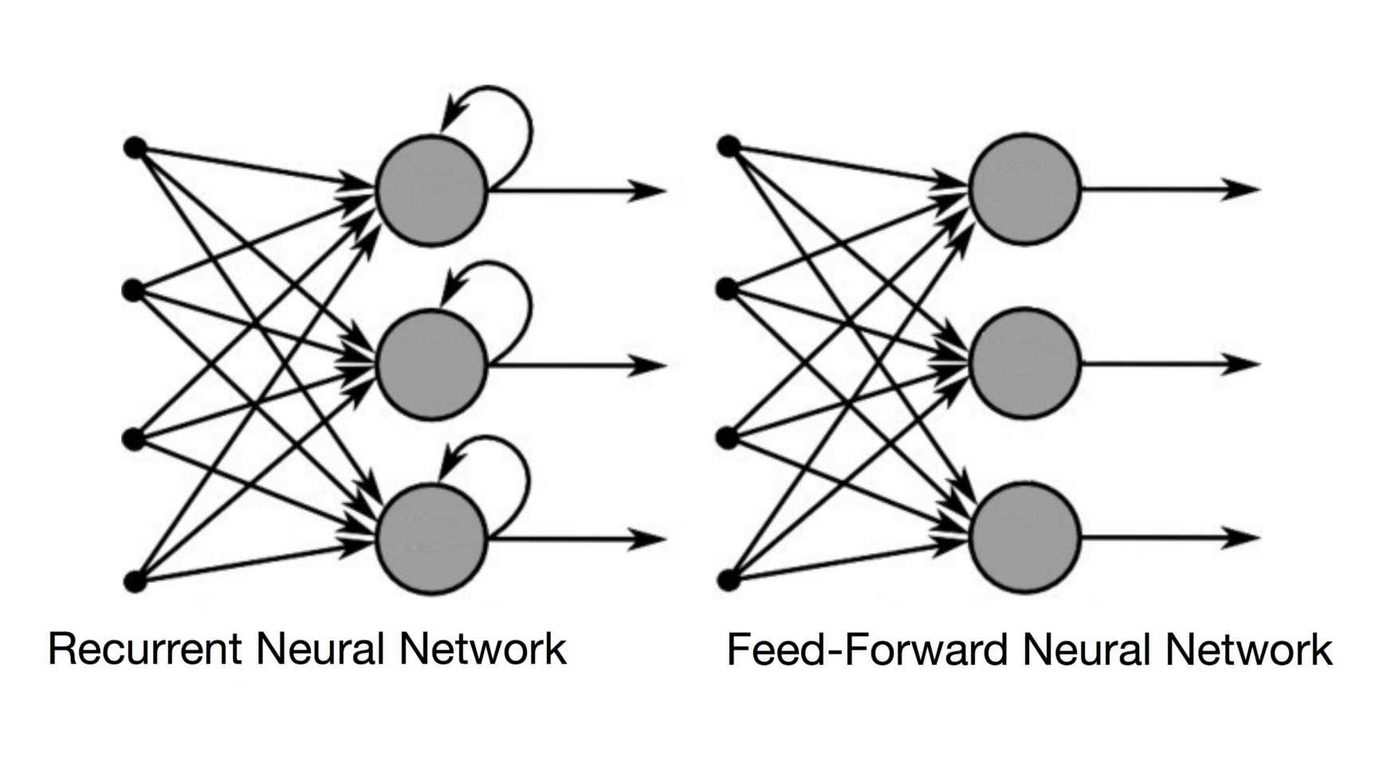
Difference between RNN and FNN
Source: https://towardsdatascience.com/recurrent-neural-networks-and-lstm-4b601dd822a5
Notes:
In a Feed-Forward NN, the information only moves in one direction, from the input layer, through the hidden layers, to the output layer. The information moves straight through the network. Because of that, the information never touches a node twice.
In a RNN, the information cycles through a loop. When it makes a decision, it takes into consideration the current input and also what it has learned from the inputs it received previously.

Slide 11
Recurrent Neural Network (RNN)
Good for Sequential data or ordered data
Internal memory: remember important things about input

Slide 12
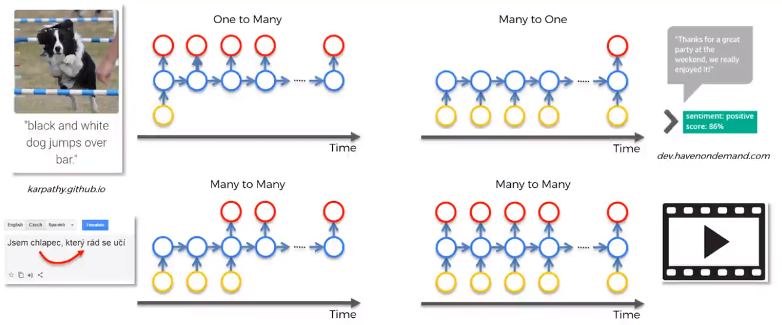
Different kinds of RNN
Image Captioning
Sentiment Analysis
Machine Translation
Video Annotation

Slide 13
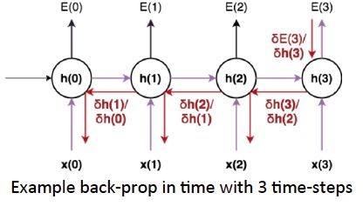
Recurrent Neural Network (RNN)
Back Propagation Through Time (BPTT):
The training method has to take into account the time operations → a cost function E is defined to train our RNN, and in this case the total error at the output of the network is the sum of the errors at each time-step

Slide 14
Recurrent Neural Network (RNN)
Main problems:
Problem 1:
Sometimes, we only need to look at recent information to perform the present task - "the clouds are in the sky"
Problem 2:
But there are also cases where we need more context - "I grew up in France… I speak fluent French.”
Source: http://colah.github.io/posts/2015-08-Understanding-LSTMs/

Slide 15
Recurrent Neural Network (RNN)
Problems
Exploding Gradients: gradients are too high: blows up and crashes the model
Vanishing Gradients: gradients are too small: model stops learning
https://medium.com/@anishsingh20/the-vanishing-gradient-problem-48ae7f501257

Slide 16
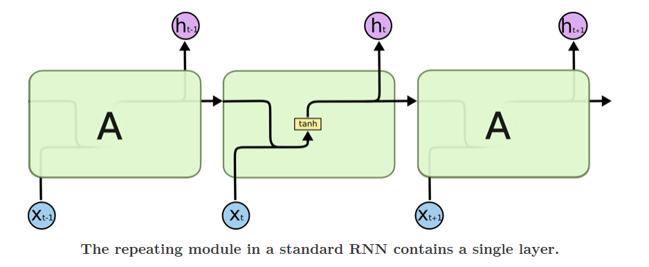
RNN Cell
Source: http://colah.github.io/posts/2015-08-Understanding-LSTMs/

Slide 17
Long Short Term Memory (LSTM)

Slide 18
Long Short Term Memory (LSTM)
Is a variant of the regular recurrent network which was designed to capture long-term dependencies in sequence data
The RNN was redesigned so that it has an activation state that can also act like weights and preserve information over long distances, hence the name “Long Short-Term Memory”

Slide 19
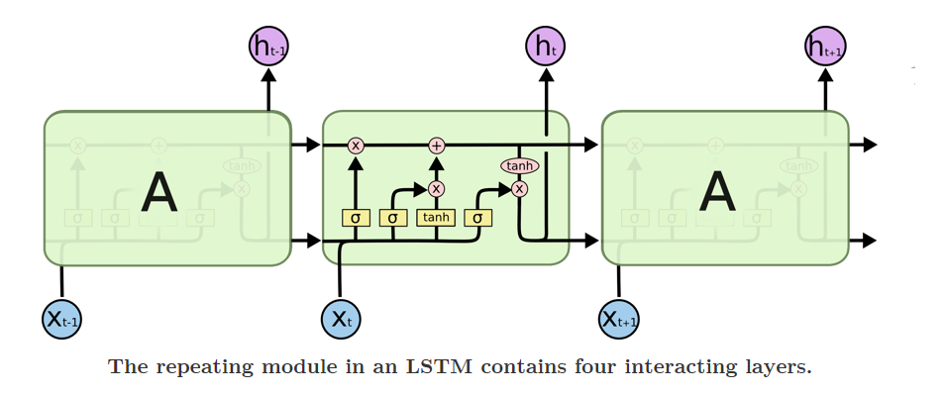
LSTM Cell
Source: http://colah.github.io/posts/2015-08-Understanding-LSTMs/

Slide 20
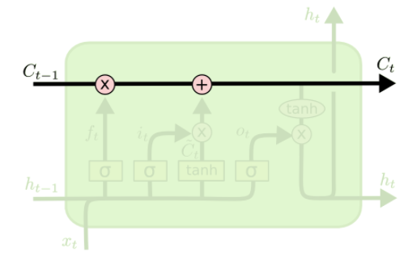
Core idea behind LSTM
The key to LSTMs is the cell state, the horizontal line running through the top of the diagram.
The LSTM does have the ability to remove or add information to the cell state, carefully regulated by structures called gates.
Source: http://colah.github.io/posts/2015-08-Understanding-LSTMs/

Slide 21
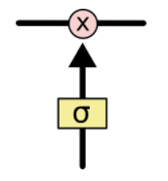
Gate
Gates are a way to optionally let information through.
They are composed out of a sigmoid neural net layer and a pointwise multiplication operation
The sigmoid layer outputs numbers between zero and one, describing how much of each component should be let through.
A value of zero means "let nothing through," while a value of one means "let everything through!"
An LSTM has three of these gates, to protect and control the cell state.
Source: http://colah.github.io/posts/2015-08-Understanding-LSTMs/

Slide 22
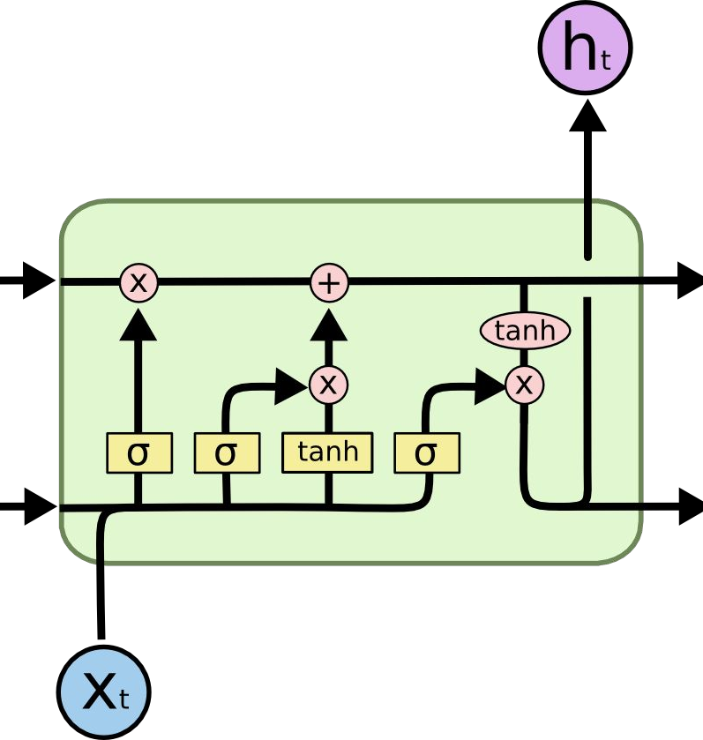
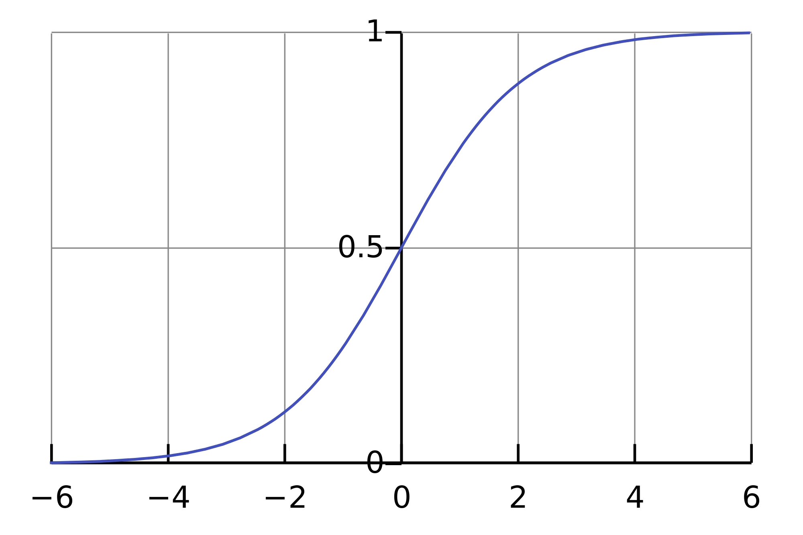
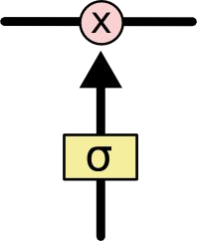
Long Short Term Memory (LSTM)
Source: http://colah.github.io/posts/2015-08-Understanding-LSTMs/

Slide 23
Meaning Of the Symbols
+ : Adding information
σ : Sigmoid layer
tanh: tanh layer
h(t-1) : Output of last LSTM unit
c(t-1) : Memory from last LSTM unit
X(t) : Current input
c(t) : New updated memory
h(t) : Current output

Slide 24
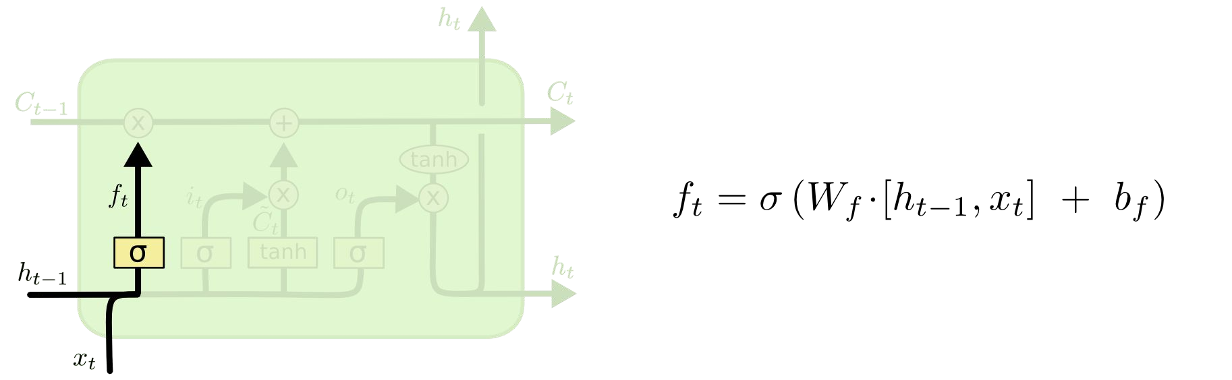
Long Short Term Memory (LSTM)
Forget Gate Layer
Source: http://colah.github.io/posts/2015-08-Understanding-LSTMs/
Notes:
The first step in our LSTM is to decide what information we’re going to throw away from the cell state.

Slide 25
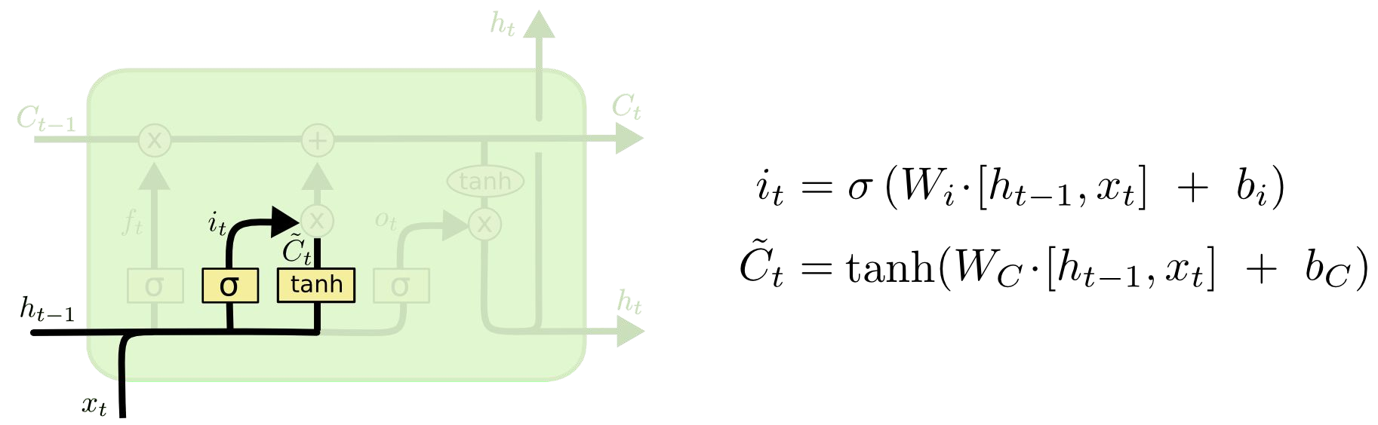
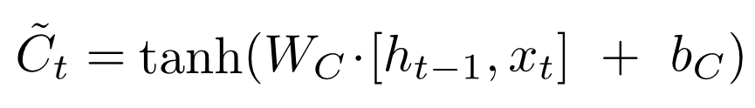
Long Short Term Memory (LSTM)
Input Gate Layer
New contribution to cell state
Source: http://colah.github.io/posts/2015-08-Understanding-LSTMs/
Notes:
The next step is to decide what new information we’re going to store in the cell state.

Slide 26
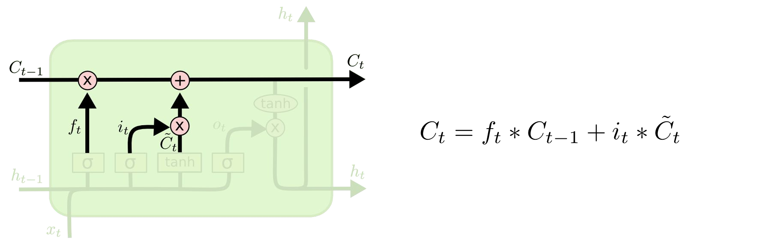
Long Short Term Memory (LSTM)
Update Cell State (memory)
Source: http://colah.github.io/posts/2015-08-Understanding-LSTMs/
Notes:
It's now time to update the old cell state Ct−1, into the new cell state Ct. The previous steps already decided what to do, we just need to actually do it.

Slide 27
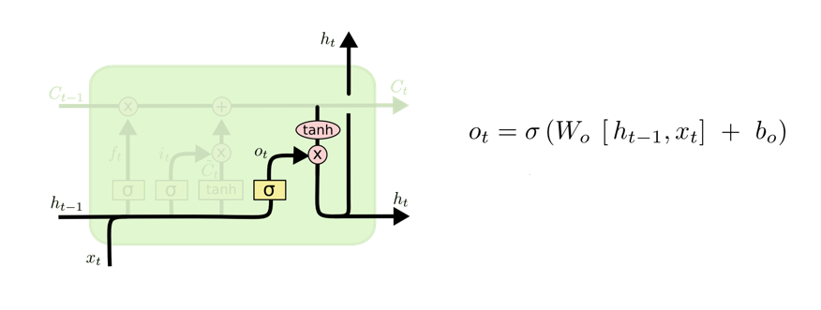

Long Short Term Memory (LSTM)
Output Gate Layer
Output to next layer
Source: http://colah.github.io/posts/2015-08-Understanding-LSTMs/
Notes:
Finally, we need to decide what we're going to output. This output will be based on our cell state, but will be a filtered version.

Slide 28

Long Short Term Memory (LSTM)
Source: http://colah.github.io/posts/2015-08-Understanding-LSTMs/

Slide 29
Model Overfitting

Slide 30
Different ways to avoid overfitting
“Overfitting refers to a model that models the training data too well”
Avoid by
Reduce the network’s capacity
Apply regularization
Use Dropout layers

Slide 31
Regularization techniques
Regularization:
Adding an extra element to the loss function, which punishes our model for being too complex or, for using too high values in the weight matrix
L1: Least Absolute Deviations (Lasso)
L2:Least Square Errors (Ridge)

Slide 32
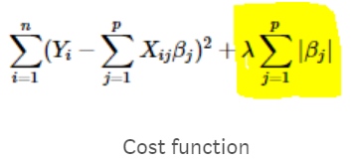
L1: Least Absolute Deviations (Lasso)
Lasso shrinks the less important feature’s coefficient to zero
Removing some feature altogether
This works well for feature selection in case we have a huge number of features

Slide 33
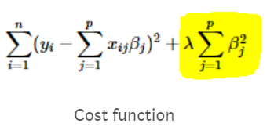
L2:Least Square Errors (Ridge)
Adds “squared magnitude” coefficient as penalty term to the loss function

Slide 34
Hyperparameter Optimization
Grid Search
Random Search
Hand-tuning
Gaussian Process with Expected Improvement
Tree-structured Parzen Estimators (TPE)

Slide 35
Hyperparameter Optimization
Grid search capability from the scikit-learn python machine learning library
Grid search is a model hyperparameter optimization technique
It tune the hyperparameters of deep learning models

Slide 36
How to Use Keras Models in scikit-learn
Keras models can be used in scikit-learn by wrapping them with the KerasClassifier or KerasRegressor class.

Slide 37
How to Tune Batch Size and Number of Epochs
model = KerasClassifier(build_fn=model,verbose=0) batch_size = [10, 20, 40] epochs = [1, 2, 3] param_grid = dict(batch_size=batch_size, epochs=epochs) from sklearn.model_selection import GridSearchCV grid = GridSearchCV(estimator=model, param_grid=param_grid, n_jobs=-1) grid_result = grid.fit(X_train, Y_train) # summarize results print("Best: %f using %s" % (grid_result.best_score_, grid_result.best_params_))

Slide 38
Results
Best: 0.846411 using {'batch_size’: 40, 'epochs’: 3}

Slide 39
List of hyperparameters to be tuned
Optimization Algorithm
optimizer = ['SGD', 'RMSprop', 'Adagrad', 'Adadelta', 'Adam', 'Adamax', 'Nadam’]
Network Weight Initialization
init_mode = ['uniform', 'lecun_uniform', 'normal', 'zero', 'glorot_normal', 'glorot_uniform', 'he_normal', 'he_uniform’]
Neuron Activation Function
activation = ['softmax', 'softplus', 'softsign', 'relu', 'tanh', 'sigmoid', 'hard_sigmoid', 'linear’]
Dropout Regularization
dropout_rate = [0.0, 0.1, 0.2, 0.3, 0.4, 0.5, 0.6, 0.7, 0.8, 0.9]

Slide 40
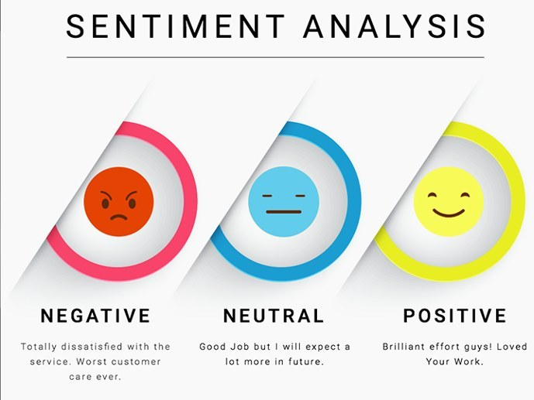
Use case: Sentiment Analysis using LSTM

Slide 41
Sentiment Classification
The process of computationally identifying and categorizing opinions expressed in a piece of text
In order to determine whether the writer's attitude towards a particular topic, product, etc. is positive, negative, or neutral.

Slide 42
First GOP Debate Twitter Sentiment
Analyze tweets on the first 2016 GOP Presidential Debate

Slide 43
keeping the necessary columns
Only keeping the necessary columns.
data = pd.read_csv('../input/Sentiment.csv’)
# Keeping only the neccessary columns
data = data[['text','sentiment']]

Slide 44
Filtering the tweets, using Tokenizer to vectorize, convert text into Sequences
data = data[data.sentiment != "Neutral"]
data['text'] = data['text'].apply(lambda x: x.lower())
data['text'] = data['text'].apply((lambda x: re.sub('[^a-zA-z0-9\s]','',x)))
(data[ data['sentiment'] == 'Positive'].size)
(data[ data['sentiment'] == 'Negative'].size)
for idx,row in data.iterrows():
row[0] = row[0].replace('rt',' ‘)
max_fatures = 2000
tokenizer = Tokenizer(num_words=max_fatures, split=' ‘)
tokenizer.fit_on_texts(data['text'].values)
X = tokenizer.texts_to_sequences(data['text'].values)
X = pad_sequences(X)

Slide 45
composing the LSTM Network
embed_dim = 128
lstm_out = 196
model = Sequential()
model.add(Embedding(max_fatures, embed_dim,input_length = X.shape[1]))
model.add(SpatialDropout1D(0.4))
model.add(LSTM(lstm_out, dropout=0.2, recurrent_dropout=0.2))
model.add(Dense(2,activation='softmax’))
model.compile(loss = 'categorical_crossentropy', optimizer='adam',metrics = ['accuracy'])
(model.summary())

Slide 46
Defining training and test data
Y = pd.get_dummies(data['sentiment']).values
X_train, X_test, Y_train, Y_test = train_test_split(X,Y, test_size = 0.33, random_state = 42)
(X_train.shape,Y_train.shape)
(X_test.shape,Y_test.shape)
batch_size = 32
model.fit(X_train, Y_train, epochs = 7, batch_size=batch_size, verbose = 2)

Slide 47
Evaluating the model
validation_size = 1500
X_validate = X_test[-validation_size:]
Y_validate = Y_test[-validation_size:]
X_test = X_test[:-validation_size]
Y_test = Y_test[:-validation_size]
score,acc = model.evaluate(X_test, Y_test, verbose = 2, batch_size = batch_size)
("score: %.2f" % (score))
("acc: %.2f" % (acc))

Slide 48
References
https://medium.com/the-theory-of-everything/understanding-activation-functions-in-neural-networks-9491262884e0
https://towardsdatascience.com/lstm-by-example-using-tensorflow-feb0c1968537
https://medium.com/@erikhallstrm/hello-world-rnn-83cd7105b767
https://towardsdatascience.com/exploring-activation-functions-for-neural-networks-73498da59b02
https://medium.com/lingvo-masino/introduction-to-recurrent-neural-network-d77a3fe2c56c
http://colah.github.io/posts/2015-08-Understanding-LSTMs/
https://www.slideshare.net/ashraybhandare/deep-learning-cnn-and-rnn?qid=0f39b4da-a290-4e9e-9d31-ed21816598e3&v=&b=&from_search=27
https://medium.freecodecamp.org/how-to-become-a-data-scientist-2d829fa33aba
https://machinelearningmastery.com/truncated-backpropagation-through-time-in-keras/
https://stats.stackexchange.com/questions/270546/how-does-keras-embedding-layer-work
https://medium.com/explore-artificial-intelligence/an-introduction-to-recurrent-neural-networks-72c97bf0912
https://medium.com/datadriveninvestor/how-do-lstm-networks-solve-the-problem-of-vanishing-gradients-a6784971a577

